Slide 1
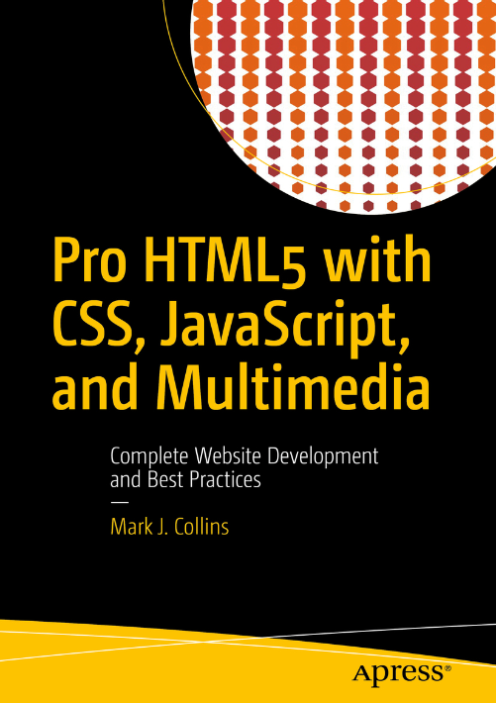
Core web development PART I

Slide 2
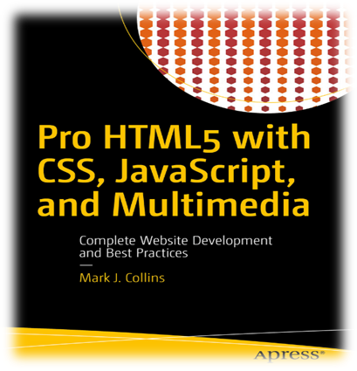
CW412 Lesson one | Introduction
The module code is: CW412.
The module name: Core Web Development.
There are three formatives to be completed and group activities.
The module has 2 compulsory international exams.
The main resource book is found on O’Reilly
Title: Pro HTML5 with CSS, JavaScript, and Multimedia.
Author: Mark J. Collins.
Publisher: Apress.
Release Date: March 2017.
ISBN : 978-1-4842-2462-5.
2022 CTU Training Solutions | All Rights Reserved | ctutraining.ac.za

Slide 3
COURSE OUTLINE
PART I HTML5 Technologies | PART II HTML | PART III CSS | PART IV JAVASCRIPT | PART V Advanced Applications
Chapter 1:​ Hypertext Markup Language | Chapter 4:​ Structural HTML Elements | Chapter 9:​ CSS Selectors | Chapter 16:​ Browser Environment | Chapter 21:​ Audio and Video
Chapter 2:​ Cascading Style Sheets | Chapter 5:​ Phrasing HTML Elements | Chapter 10:​ Positioning | Chapter 17:​ Window Object | Chapter 22:​ Scalable Vector Graphics
Chapter 3:​ JavaScript Essentials | Chapter 6:​ Table HTML Elements | Chapter 11:​ Text Styles | Chapter 18:​ DOM Elements | Chapter 23:​ Canvas
 | Chapter 7:​ Embedded HTML Elements | Chapter 12:​ Borders and Backgrounds | Chapter 19:​ Dynamic Styling | Chapter 24:​ Drag and Drop
 | Chapter 8:​ HTML Form Elements | Chapter 13:​ Styling Tables | Chapter 20:​ Events | Chapter 25:​ Indexed DB
 |  | Chapter 14:​ Flexbox |  | Chapter 26:​ Geolocation and Mapping
 |  | Chapter 15:​ Animation and Transforms
2022 CTU Training Solutions | All Rights Reserved | ctutraining.ac.za

Slide 4

PART IV: OBJECTIVES
Understanding HTML 5
Understanding CSS
Understanding JavaScript
2022 CTU Training Solutions | All Rights Reserved | ctutraining.ac.za

Slide 5

UNDERSTANDING HTML.
OBJECTIVE 1

Slide 6
Part I | What is HTML ?
Main Heading | Subheading
HTML is the standard markup language for creating Web pages.
HTML stands for Hyper Text Markup Language
A hyper document is one that contains links to other “things” or places either within or outside the document.
Html is a type of Standard Generalized Markup Language(SGML). It is portable, meaning it allows all sort of computers, all across the world to view documents created in any SGML.
A markup language is a computer language that uses tags to define elements within a document. It is human-readable, meaning markup files contain standard words, rather than typical programming syntax.
HTML describes the structure of Web pages using markup
HTML elements are the building blocks of HTML pages
HTML elements are represented by tags
HTML tags label pieces of content such as "heading", "paragraph", "table", and so on
Browsers do not display the HTML tags, but use them to render the content of the page
The founder of HTML was Tim Berners-Lee and his product was made attractive to the general public by Mosaic browser which was evolved at NCSA.
2020 CTU Training Solutions | All Rights Reserved | ctutraining.ac.za
2022 CTU Training Solutions | All Rights Reserved | ctutraining.ac.za

Slide 7




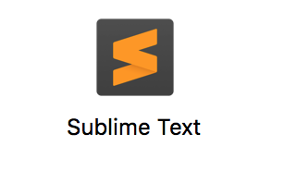


Part I | HTML Text Editors ?
Main Heading | Subheading
We can develop HTML Web pages using the following text editors:
Froala
HTMLPad
UltraEdit
Sublime Text
Atom
Notepad++
CoffeeCup
2020 CTU Training Solutions | All Rights Reserved | ctutraining.ac.za
2022 CTU Training Solutions | All Rights Reserved | ctutraining.ac.za

Slide 8
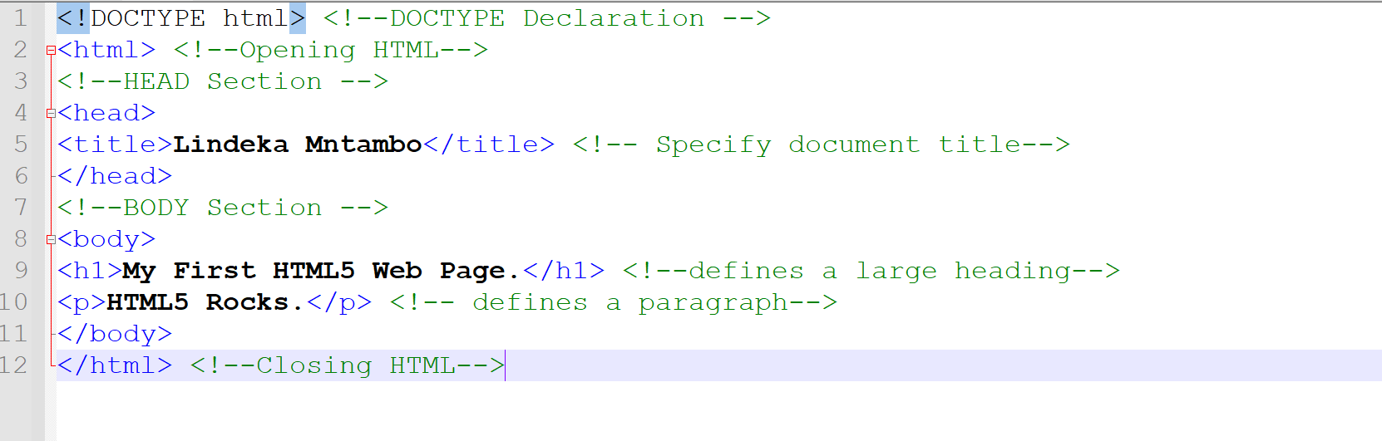
Part I | A Simple HTML Document
Main Heading | Subheading
2020 CTU Training Solutions | All Rights Reserved | ctutraining.ac.za
2022 CTU Training Solutions | All Rights Reserved | ctutraining.ac.za

Slide 9
Part I | HTML Elements
Main Heading | Subheading
The document is comprised of several HTML elements that are nested in a hierarchical fashion.
Like other markup languages, tags are used to annotate content with useful information. An HTML element generally follows this structure:
For example, the document title, “My First HTML5 Document” is identified by the opening and closing tags, <title> and </title>. In most cases each element has an open and close tag that are identical except the close tag is preceded by a “/” character. Sometimes the terms element and tag are used interchangeably; to be precise, however, an element is comprised of an opening and closing tag and the content that is found between these tags.
Elements will often contain other elements. Notice in the sample document that the html element contains a head and a body element.
2020 CTU Training Solutions | All Rights Reserved | ctutraining.ac.za
2022 CTU Training Solutions | All Rights Reserved | ctutraining.ac.za

Slide 10
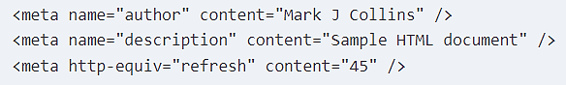
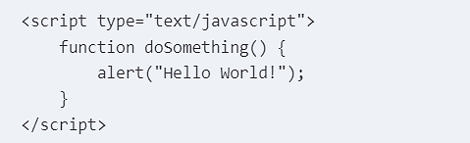
Part I | HTML Elements
The meta element is an abbreviation for metadata, which is data that describes other data. In this case, the meta element describes the contents of the HTML document. The head element can include any number of meta elements, each providing a single data point using the name/value pair construct. For example:
The script element is used to load JavaScript in your page. In order to use a function, you must either define it or load an external script file that contains the function. Either can be done in the script element. To define JavaScript directly, include it in between the opening and closing tags like this:
If you need to load multiple files, include each one in a separate script element. For example:
Main Heading | Subheading
2020 CTU Training Solutions | All Rights Reserved | ctutraining.ac.za
2022 CTU Training Solutions | All Rights Reserved | ctutraining.ac.za

Slide 11
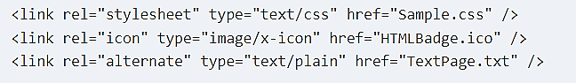
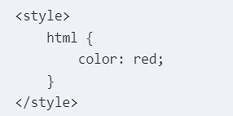
Part I | HTML Elements
The link element is used to reference additional external resources, which can be grouped into two categories. First, links are used to load resources that are used to render the source document – the most common of these being cascading style sheets. The second category is links to other related documents. The reader may choose to navigate to these documents but they are not needed to render the current page.
The specific style attributes of an element such as color or size can be specified explicitly on the element, which is referred to as inline styles. The more common, and preferred, method however, is to define a set of rules that are used to determine the specific style attributes that are applied to the entire document using style element.
Main Heading | Subheading
2020 CTU Training Solutions | All Rights Reserved | ctutraining.ac.za
2022 CTU Training Solutions | All Rights Reserved | ctutraining.ac.za

Slide 12
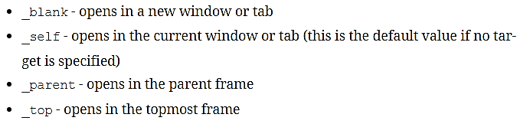
Part I | HTML Elements
The base element is used to define the base URL that should be used for all other references in the document. This allows you to use relative URLs everywhere else. This saves a bit of typing but also makes it easy if you need to change the base address. The base element supports two specific attributes: href, which defines the base URL; and target, which specifies the default behavior when a link is selected. A base element might look like this:
As you can see, the base element uses a self-closing tag. Setting the target attribute to _self indicates that the link should be opened in the same window and tab as the current page. This can be overridden by assigning a different target in a specific link. The supported values for the target attribute are these:
Main Heading | Subheading
2020 CTU Training Solutions | All Rights Reserved | ctutraining.ac.za
2022 CTU Training Solutions | All Rights Reserved | ctutraining.ac.za

Slide 13

Part I | HTML Attributes
Main Heading | Subheading
An opening tag can include one or more attributes. Attributes are used to provide details about an element. The html element, for example, contains lang="en", which informs the browser that the content is written in English. The browser may use this to offer to translate the content if English is not the current language.
The most common ones that you’ll use are id and class. The id attribute defines a unique key for an element; it must be unique within the entire HTML document. This is often used when accessing an element in JavaScript. The class attribute is sometimes called the CSS class, because it is often used for applying styles to an element. Unlike id, the class attribute is a non-unique key; a single value is applied to elements that need to have identical formatting.
Each element type may support other attributes. Notice that the meta element includes a charset attribute:
The charset attribute specifies the type of character-set encoding that this page uses. You should always define the character set; however, this is particularly important if your page needs to display nonstandard characters.
2020 CTU Training Solutions | All Rights Reserved | ctutraining.ac.za
2022 CTU Training Solutions | All Rights Reserved | ctutraining.ac.za

Slide 14
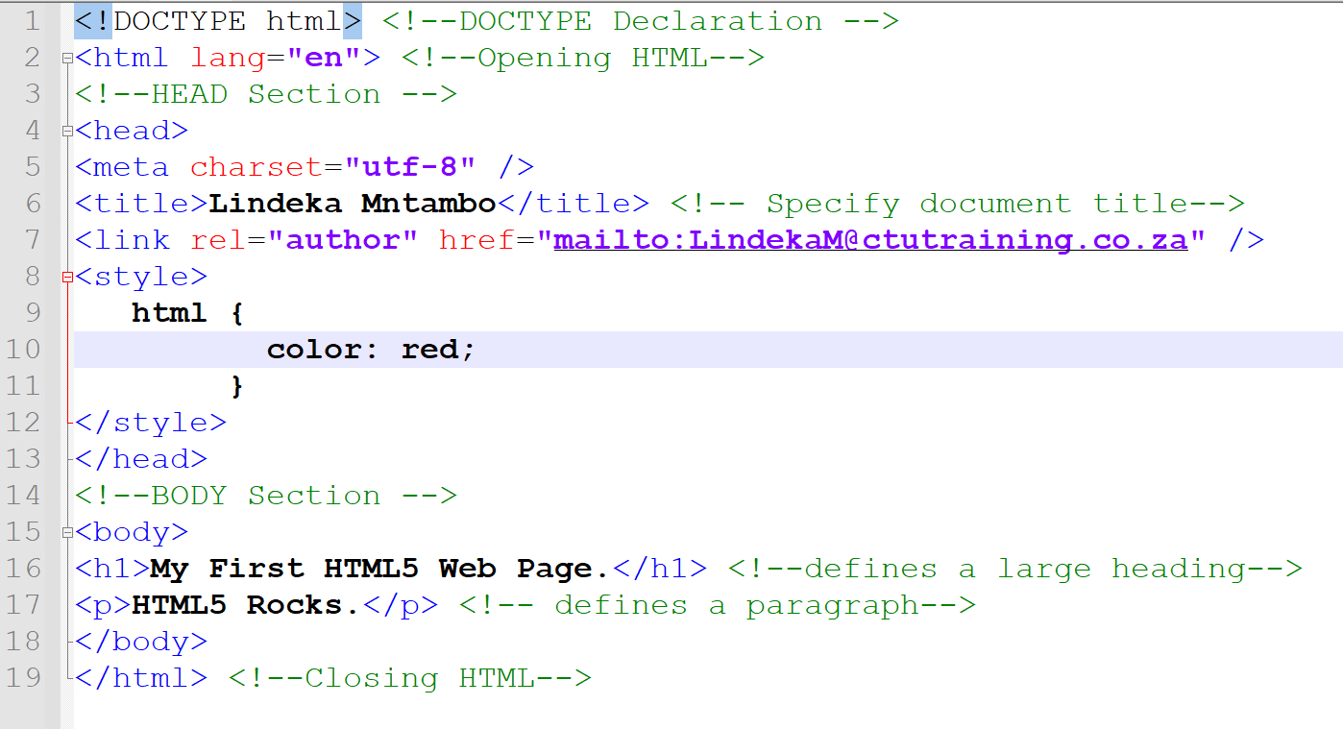
Part I | HTML Elements and Attributes
Main Heading | Subheading
2020 CTU Training Solutions | All Rights Reserved | ctutraining.ac.za
2022 CTU Training Solutions | All Rights Reserved | ctutraining.ac.za

Slide 15
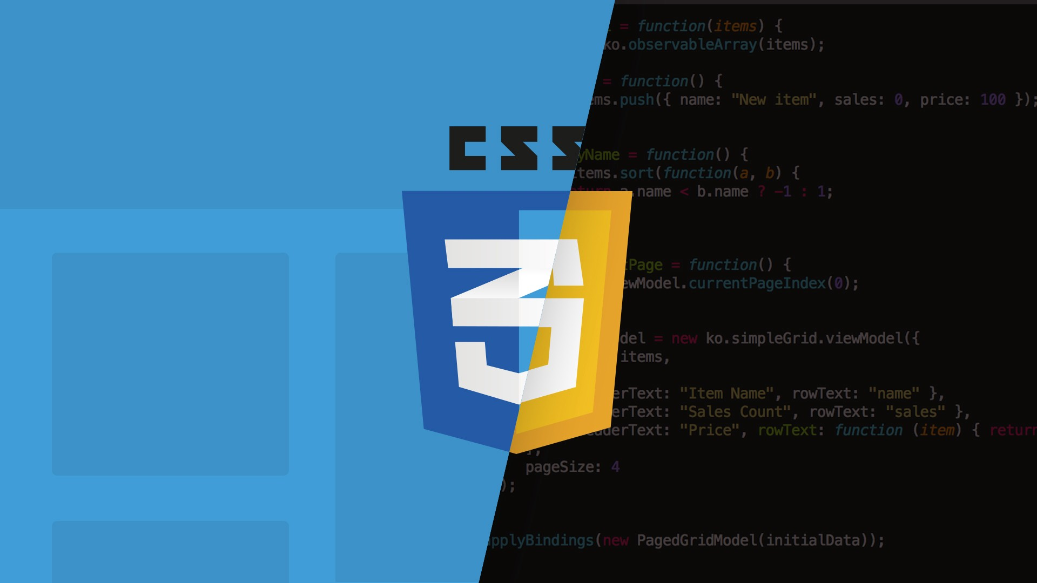
UNDERSTANDING
OBJECTIVE 2

Slide 16
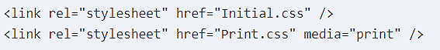
Part I | What is CSS ?
Main Heading | Subheading
Cascading Style Sheets (CSS) is used to format the layout of a webpage.
With CSS, you can control the color, font, the size of text, the spacing between elements, how elements are positioned and laid out, what background images or background colors are to be used, different displays for different devices and screen sizes, and much more!
CSS can be added to HTML documents in 3 ways:
Inline - by using the style attribute inside HTML elements
Internal - by using a <style> element in the <head> section
External - by using a <link> element to link to an external CSS file
Commonly used CSS properties:
The CSS color property defines the text color to be used.
The CSS font-family property defines the font to be used.
The CSS font-size property defines the text size to be used.
External style sheets can be referenced with a full URL or with a path relative to the current web page.
2020 CTU Training Solutions | All Rights Reserved | ctutraining.ac.za
2022 CTU Training Solutions | All Rights Reserved | ctutraining.ac.za

Slide 17
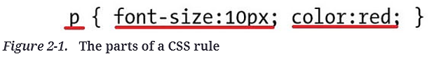
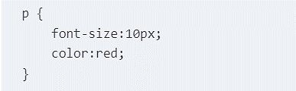
Part I | Applying Styles
Main Heading | Subheading
Once you have a well-formed and amply annotated content, you can apply the desired styling. A style sheet consists of a set of rules. A rule is sometimes referred to as a rule set or rule block. A rule is comprised of a selector that defines a set of elements that the rule should be applied to, and one or more declarations. Each declaration sets the value of a single attribute. The general form of a rule is:
A declaration includes a property and value separated by a colon, for example color:red, sets the color attribute of the element to red. The parts of a rule are shown in Figure; the selector is p, which selects all of the paragraph elements, and the declarations set the font-size and color attributes.
As with HTML, white spaces are ignored in CSS, so this is often written as:
2020 CTU Training Solutions | All Rights Reserved | ctutraining.ac.za
2022 CTU Training Solutions | All Rights Reserved | ctutraining.ac.za

Slide 18
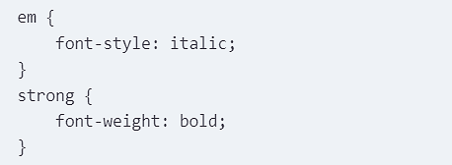
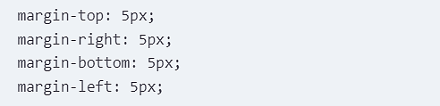
Part I | CSS Selectors
Selectors are very powerful, especially with the many improvements in CSS3, but can take some effort to master them. One of the most common selectors is the element selector. In its simplest form, you specify the type of element that the declaration should apply to. For example:
Using this rule, all content in an emphasis element will use an italic font type. Likewise, a bold font will be used for all strong elements.
CSS supports shortcuts that allow you to specify multiple attributes in a single declaration. The margin attribute is a good example of this. The margin attribute specifies the amount of space between an element and its neighbors. The space above, below, to the left, and to the right can be specified independently. To set these all to 5 pixels you can use the following declarations:
Main Heading | Subheading
2020 CTU Training Solutions | All Rights Reserved | ctutraining.ac.za
2022 CTU Training Solutions | All Rights Reserved | ctutraining.ac.za

Slide 19
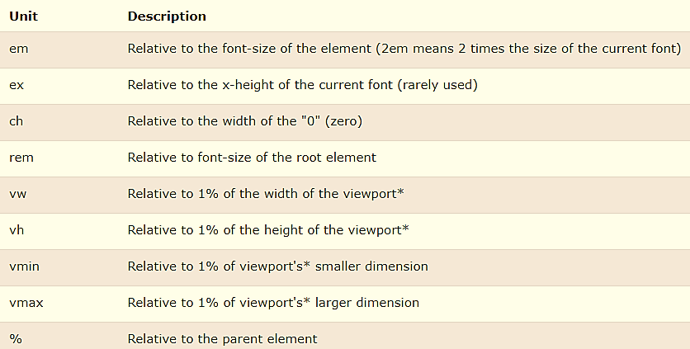
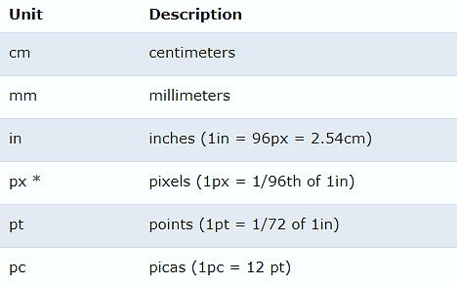
Part I | CSS Units
CSS has several different units for expressing a length. Many CSS properties take "length" values, such as width, margin, padding, font-size, etc. Length is a number followed by a length unit, such as 10px, 2em, etc. A whitespace cannot appear between the number and the unit. However, if the value is 0, the unit can be omitted.
The absolute length units are fixed, and a length expressed in any of these will appear as exactly that size.
Relative length units specify a length relative to another length property. Relative length units scale better between different rendering medium.
Main Heading | Subheading
2020 CTU Training Solutions | All Rights Reserved | ctutraining.ac.za
2022 CTU Training Solutions | All Rights Reserved | ctutraining.ac.za

Slide 20
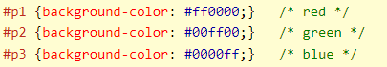
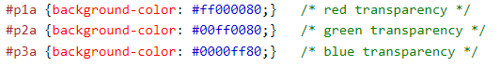
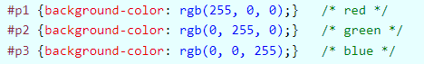
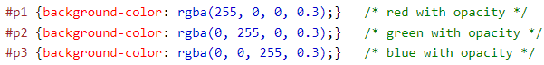
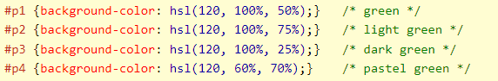
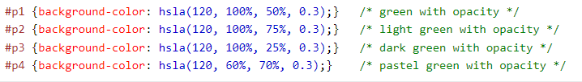
Part I | CSS Colors
Colors in CSS can be specified by the following methods:
Hexadecimal colors
Hexadecimal colors with transparency
RGB colors
RGBA colors
HSL colors
HSLA colors
Predefined/Cross-browser color names
With the currentcolor keyword
More about colors:
https://www.w3.org/TR/css3-color/#svg-color .
Main Heading | Subheading
2020 CTU Training Solutions | All Rights Reserved | ctutraining.ac.za
2022 CTU Training Solutions | All Rights Reserved | ctutraining.ac.za

Slide 21
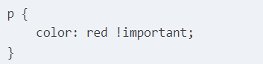
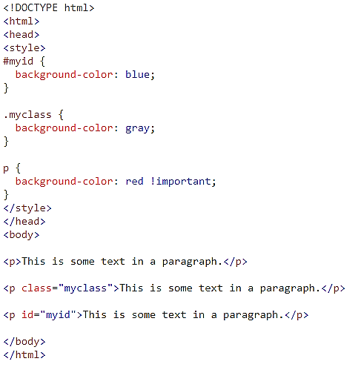
Part I | CSS Important Keyword
The one sort of “ace-in-the-hole” is the !important keyword . If this is used in a style rule, this trumps all other rules. You can add the !important keyword like this:
Keep in mind that the !important keyword is applied in the declaration, not the rule. It only applies to a single declaration and must be repeated on each declaration that you want it applied to.
Main Heading | Subheading
2020 CTU Training Solutions | All Rights Reserved | ctutraining.ac.za
2022 CTU Training Solutions | All Rights Reserved | ctutraining.ac.za

Slide 22
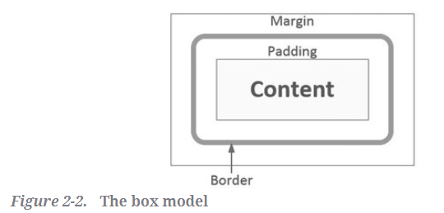
Part I | CSS Box Model
Each element in the document takes up a certain amount of space, which depends on the content of that element. In addition, factors such as padding, and margin affect this. Padding is the space between the content and the element’s border. The margin is the space between the border and adjacent elements. This is illustrated in Figure 2-2.
Content - The content of the box, where text and images appear
Padding - Clears an area around the content. The padding is transparent
Border - A border that goes around the padding and content
Margin - Clears an area outside the border. The margin is transparent
The box model allows us to add a border around elements, and to define space between elements.
Main Heading | Subheading
2020 CTU Training Solutions | All Rights Reserved | ctutraining.ac.za
2022 CTU Training Solutions | All Rights Reserved | ctutraining.ac.za
Notes:
Explain from the slide.

Slide 23
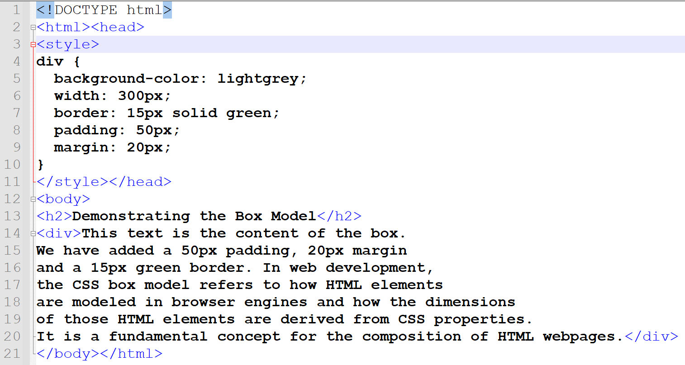
Part I | Box Model
Main Heading | Subheading
2020 CTU Training Solutions | All Rights Reserved | ctutraining.ac.za
2022 CTU Training Solutions | All Rights Reserved | ctutraining.ac.za

Slide 24
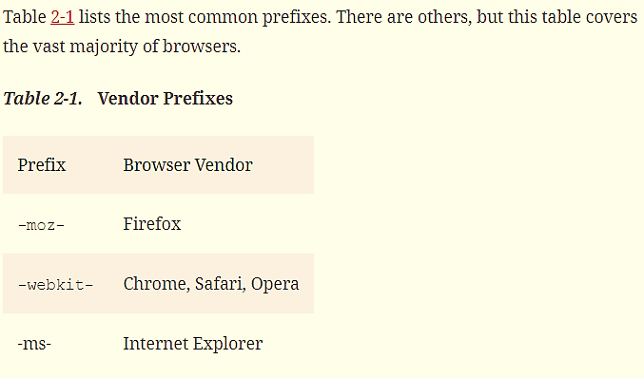
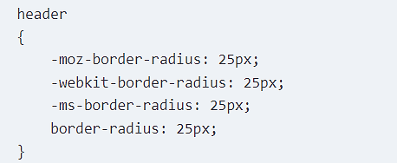
Part I | CSS Vendor Prefixes
Oh, the joys of living on the edge! As with other areas of HTML5, browser vendors will have varying support for the CSS specifications. In many cases, however, these vendors implement new properties before they become part of the official recommendation. In fact, much of what is being included in the CSS3 specification has already been available from one or more browsers.
When a browser vendor adds a new feature that is not part of the CSS3 recommendation, the property is given a vendor-specific prefix to indicate this is a nonstandard feature. If this becomes part of the recommendation, the prefix is eventually dropped. For example, to specify the border radius, in addition to the standard border-radius property, you may need to set all of the vendor-specific properties as well like this:
Main Heading | Subheading
2020 CTU Training Solutions | All Rights Reserved | ctutraining.ac.za
2022 CTU Training Solutions | All Rights Reserved | ctutraining.ac.za

Slide 25

UNDERSTANDING
OBJECTIVE 2

Slide 26
Part I | What is JavaScript ?
JavaScript is a lightweight, interpreted scripting language. It is designed for creating network-centric applications. It is complimentary to and integrated with Java. JavaScript is very easy to implement because it is integrated with HTML. It is open and cross-platform.
JavaScript is a MUST for students and working professionals to become a great Software Engineer specially when they are working in Web Development Domain. Advantages of learning JavaScript:
Once you learn JavaScript, it helps you developing great front-end as well as back-end software's using different JavaScript based frameworks like jQuery, Node.JS etc.
JavaScript is everywhere, it comes installed on every modern web browser For example Chrome, Mozilla Firefox , Safari and every browser you know as of today, supports JavaScript.
JavaScript helps you create really beautiful and crazy fast websites. You can develop your website with a console like look and feel and give your users the best Graphical User Experience.
JavaScript usage has now extended to mobile app development, desktop app development, and game development. This opens many opportunities for you as JavaScript Programmer.
Due to high demand, there is tons of job growth and high pay for those who know JavaScript.
Great thing about JavaScript is that you will find tons of frameworks and Libraries already developed which can be used directly in your software development to reduce your time to market.
Main Heading | Subheading
2020 CTU Training Solutions | All Rights Reserved | ctutraining.ac.za
2022 CTU Training Solutions | All Rights Reserved | ctutraining.ac.za

Slide 27
Part I | JavaScript Variable
Main Heading | Subheading
Variables are containers for storing data (storing data values).
All JavaScript variables must be identified with unique names called identifiers.
Identifiers can be short names (like x and y) or more descriptive names (age, sum, totalVolume).
The general rules for constructing names for variables (unique identifiers) are:
Names can contain letters, digits, underscores, and dollar signs.
Names must begin with a letter
Names can also begin with $ and _ (but we will not use it in this tutorial)
Names are case sensitive (y and Y are different variables)
Reserved words (like JavaScript keywords) cannot be used as names
A variable’s scope determines where it can be accessed. If a variable is declared outside of a function body it will have global scope, which simply means that all functions will have access to it.
Variables declared inside a function are considered to have local scope. The variable is only available to the code within the function. The variable is no longer available once the function returns.
2020 CTU Training Solutions | All Rights Reserved | ctutraining.ac.za
2022 CTU Training Solutions | All Rights Reserved | ctutraining.ac.za

Slide 28
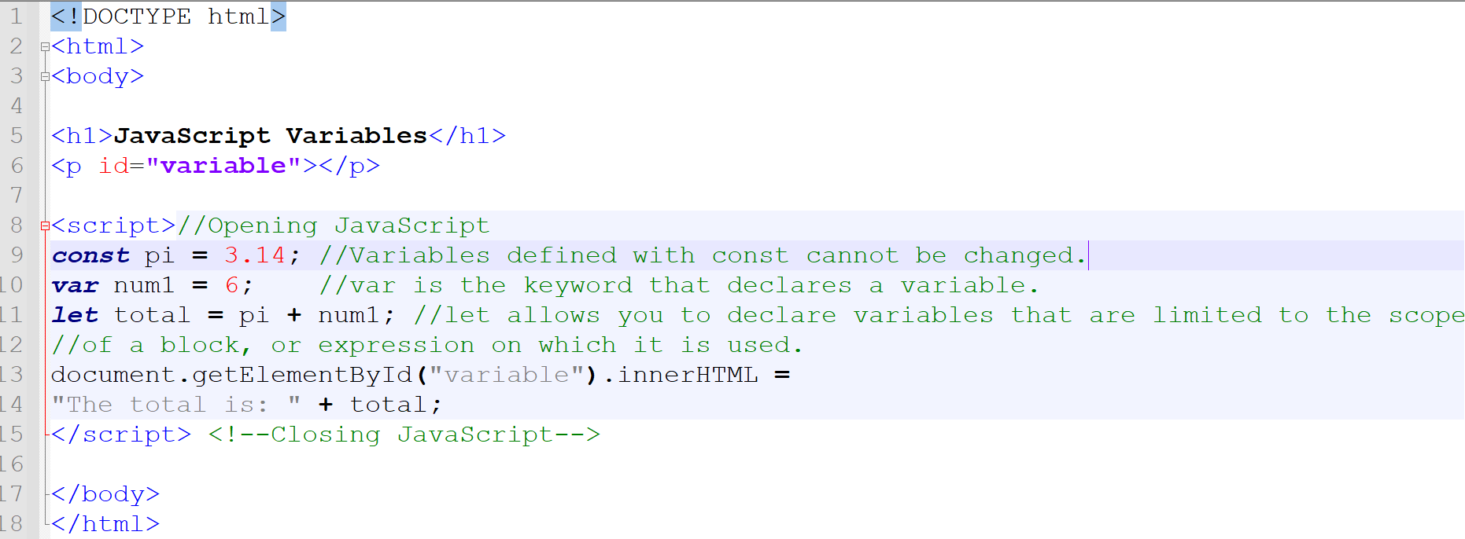
Part I | JS Variables
Main Heading | Subheading
2020 CTU Training Solutions | All Rights Reserved | ctutraining.ac.za
2022 CTU Training Solutions | All Rights Reserved | ctutraining.ac.za

Slide 29
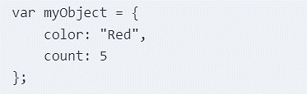
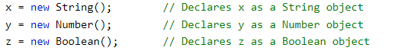
Part I | JavaScript Objects
Main Heading | Subheading
The main building block in JavaScript is an object. An object is a collection of elements; each element can either be a property or a method. A property holds a single data value, and a method will perform some action that is defined as a function. Another way of stating this is that a property is simply a variable (note the var keyword) that is defined on an object. Likewise, a method is a function that is defined on an object.
The easiest way to create an object is by specifying the members through a set of name/value pairs like this:
Another way to create an object is to use an object constructor. This uses the new keyword and invokes the default constructor.
2020 CTU Training Solutions | All Rights Reserved | ctutraining.ac.za
2022 CTU Training Solutions | All Rights Reserved | ctutraining.ac.za

Slide 30
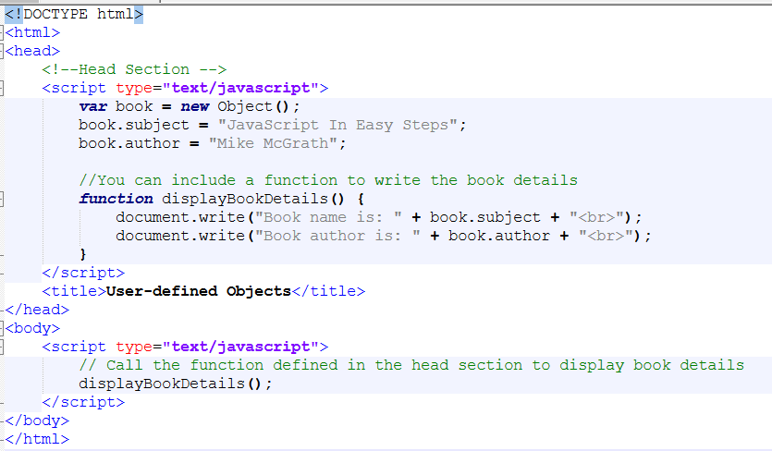
Part I | JS Objects
Main Heading | Subheading
2020 CTU Training Solutions | All Rights Reserved | ctutraining.ac.za
2022 CTU Training Solutions | All Rights Reserved | ctutraining.ac.za

Slide 31
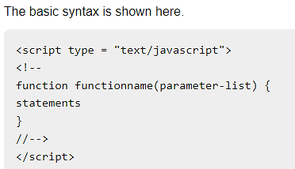
Part I | JavaScript Functions
Main Heading | Subheading
A function is a group of reusable code which can be called anywhere in your program. This eliminates the need of writing the same code again and again. It helps programmers in writing modular codes. Functions allow a programmer to divide a big program into a number of small and manageable functions.
JavaScript also supports all the features necessary to write modular code using functions. JavaScript allows us to write our own functions as well.
Before we use a function, we need to define it. The most common way to define a function in JavaScript is by using the function keyword, followed by a unique function name, a list of parameters (that might be empty), and a statement block surrounded by curly braces.
2020 CTU Training Solutions | All Rights Reserved | ctutraining.ac.za
2022 CTU Training Solutions | All Rights Reserved | ctutraining.ac.za

Slide 32
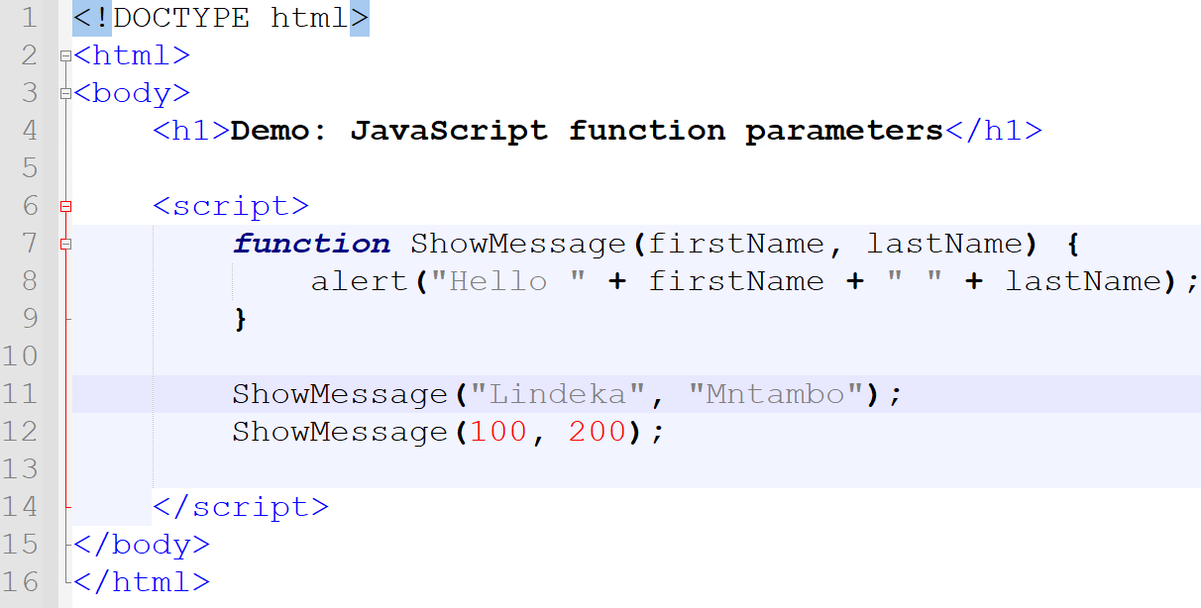
Part I | JS function
Main Heading | Subheading
2020 CTU Training Solutions | All Rights Reserved | ctutraining.ac.za
2022 CTU Training Solutions | All Rights Reserved | ctutraining.ac.za

Slide 33
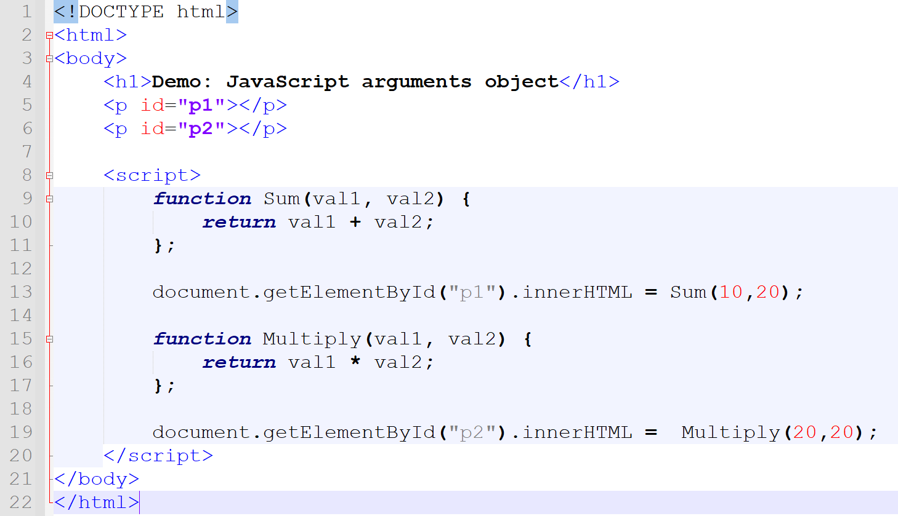
Part I | JS function with Return
Main Heading | Subheading
2020 CTU Training Solutions | All Rights Reserved | ctutraining.ac.za
2022 CTU Training Solutions | All Rights Reserved | ctutraining.ac.za

Slide 34

Part I | JavaScript Constructors
Main Heading | Subheading
A constructor is a special function that creates and initializes an object instance of a class. In JavaScript, a constructor gets called when an object is created using the new keyword.
The purpose of a constructor is to create a new object and set values for any existing object properties.
When a constructor gets invoked in JavaScript, the following sequence of operations take place:
A new empty object gets created.
The this keyword begins to refer to the new object and it becomes the current instance object.
The new object is then returned as the return value of the constructor.
All objects have a prototype. A prototype is a model or blueprint from which actual objects are instantiated. What if you needed an additional property? You can add a property to an existing object like this:
OOPs restrict direct access to its methods and variables by encapsulating the code and data together. In JavaScript, the data binds with the functions acting on that data in the process of achieving encapsulation in order to control the data and validate it.
2020 CTU Training Solutions | All Rights Reserved | ctutraining.ac.za
2022 CTU Training Solutions | All Rights Reserved | ctutraining.ac.za

Slide 35
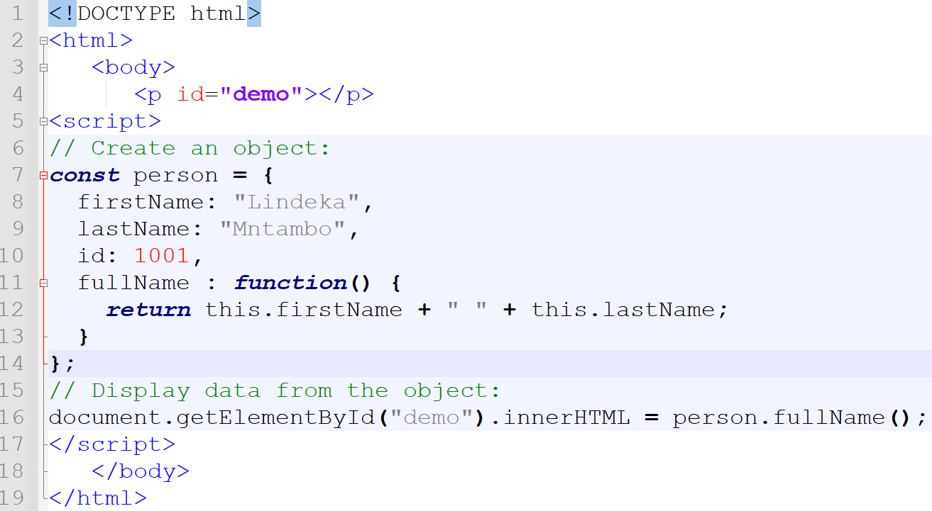
Part I | JS this keyword
Main Heading | Subheading
2020 CTU Training Solutions | All Rights Reserved | ctutraining.ac.za
2022 CTU Training Solutions | All Rights Reserved | ctutraining.ac.za

Slide 36
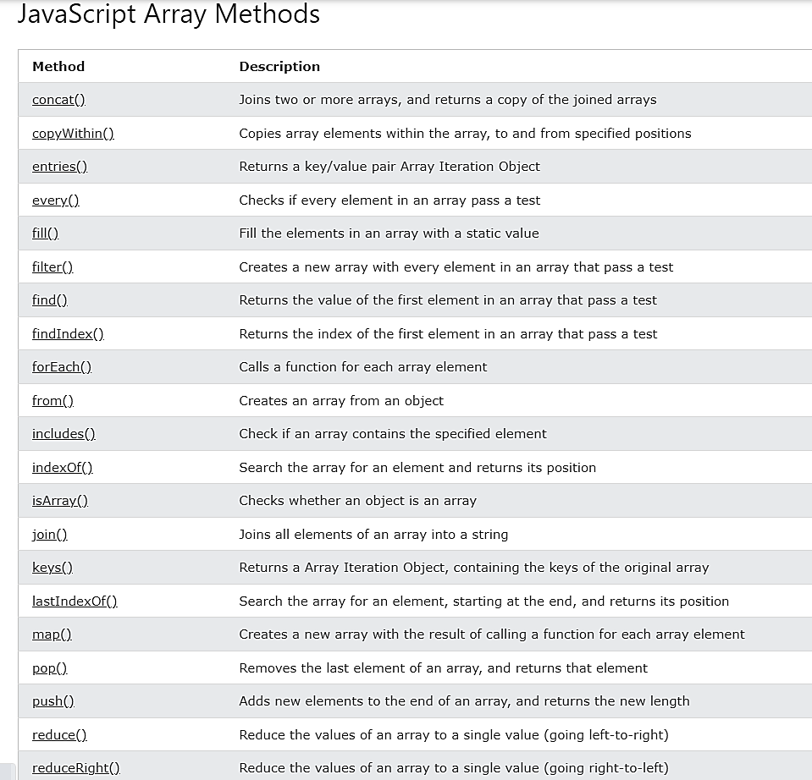
Part I | JavaScript Arrays
An array in JavaScript is simply a collection of properties. The array itself has a name and can be a member of an object or a variable. The items in the array are accessed by a numerical index. An array is created using a literal notation, for example:
An array is a special variable, which can hold more than one value:
Main Heading | Subheading
2020 CTU Training Solutions | All Rights Reserved | ctutraining.ac.za
2022 CTU Training Solutions | All Rights Reserved | ctutraining.ac.za

Slide 37
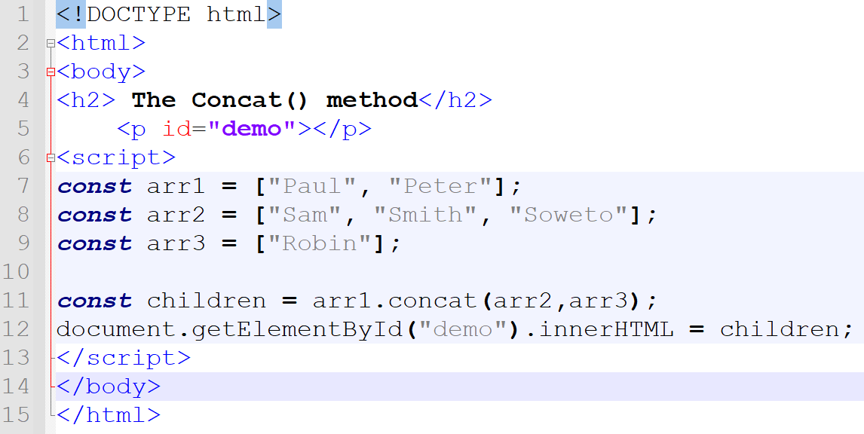
Part I | JS Arrays
Main Heading | Subheading
2020 CTU Training Solutions | All Rights Reserved | ctutraining.ac.za
2022 CTU Training Solutions | All Rights Reserved | ctutraining.ac.za

Slide 38
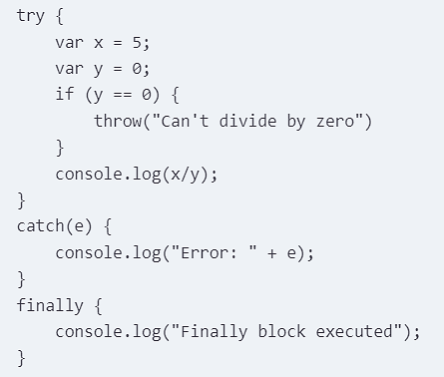
Part I | JavaScript Exceptions
JavaScript supports a try/catch/finally pattern that is similar to what you’ll find in other languages such as C#. Code that can potentially fail should be put into a try block. If an exception is raised within the try block, the catch block will be executed. The finally block is always executed, whether an error occurs or not.
You can also generate an exception in your code using the throw() function. This allows you to put the error handling in the catch block and keep your main code cleaner. Here is a simple example of these constructs:
Main Heading | Subheading
2020 CTU Training Solutions | All Rights Reserved | ctutraining.ac.za
2022 CTU Training Solutions | All Rights Reserved | ctutraining.ac.za

Slide 39
Part I | JavaScript Promises
A promise is a standardized way of dealing with asynchronous function calls. In practice, it is simply a callback function with two parameters: one function to be called on success and a second to be called on a failure. A promise can be in one of three states:
Pending - the operation has not completed
Fulfilled - the operation completed successfully
Rejected - an error occurred during processing
Sometimes fulfilled and rejected are collectively referred to as settled. Let’s look at a simple example that uses a promise. The getNumber() function waits 2 seconds and then generates a random number between 0 and 100. If you requested an even number and the random number is even, the function returns success.
The getNumber() function returns a Promise object, which is a function with two parameters. The work is done inside this inner function. Because the code is inside the getNumber() function, it has access to its variables such as the bEven parameter. The fulfill() and reject() function references are passed into the inner function and one of the two is called when the inner function completes.
Main Heading | Subheading
2020 CTU Training Solutions | All Rights Reserved | ctutraining.ac.za
2022 CTU Training Solutions | All Rights Reserved | ctutraining.ac.za

Slide 40
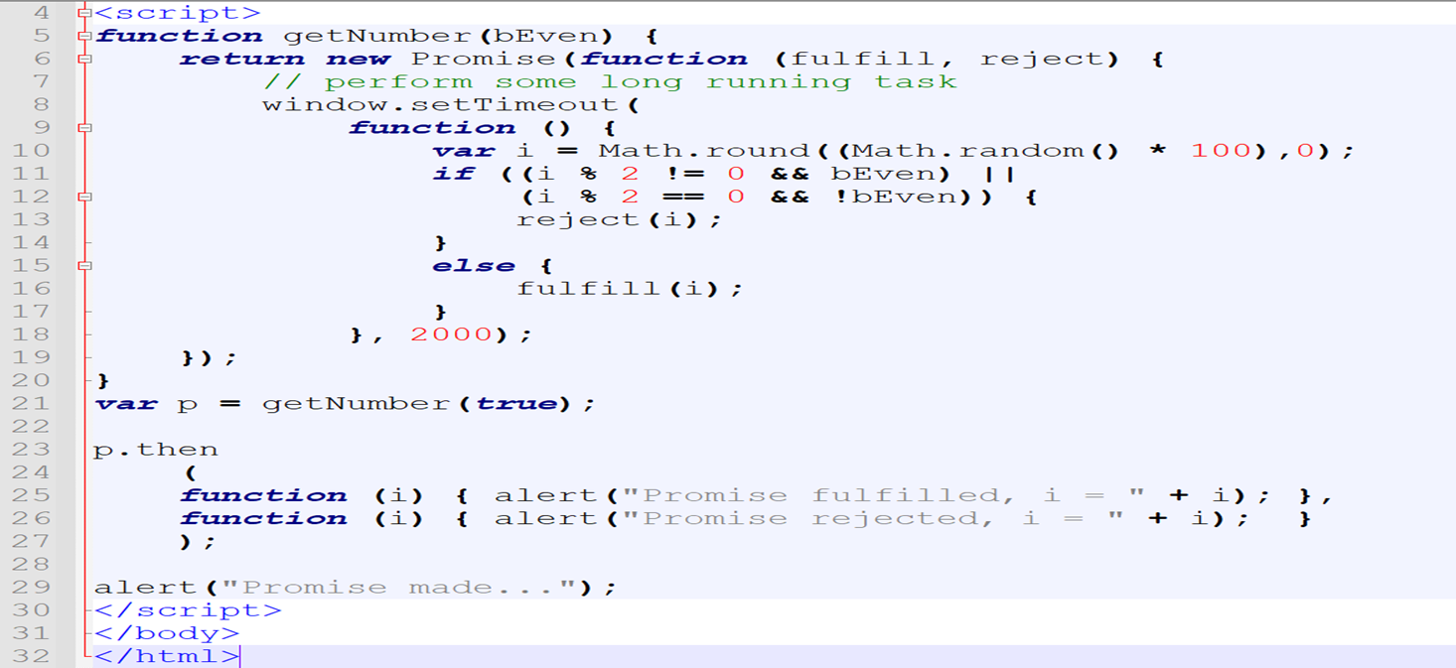
Part I | JS Promises
Main Heading | Subheading
2020 CTU Training Solutions | All Rights Reserved | ctutraining.ac.za
2022 CTU Training Solutions | All Rights Reserved | ctutraining.ac.za

Slide 41
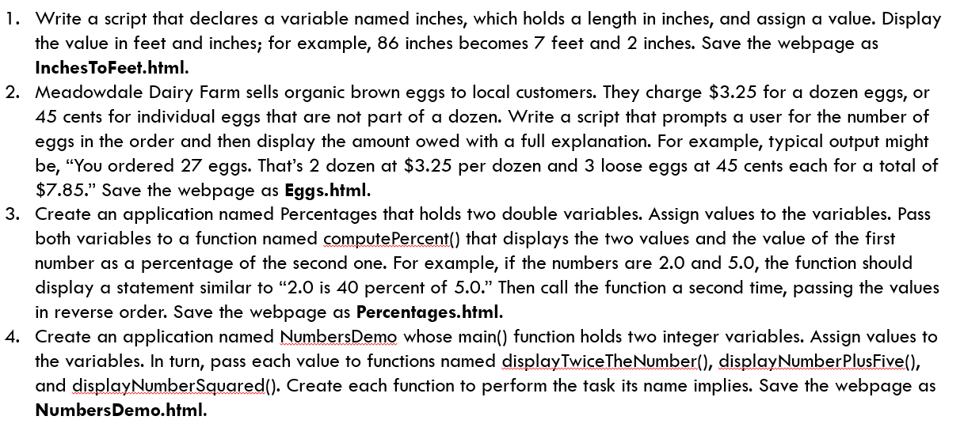
Part I | Activity
Main Heading | Subheading
2020 CTU Training Solutions | All Rights Reserved | ctutraining.ac.za
2022 CTU Training Solutions | All Rights Reserved | ctutraining.ac.za

Slide 42
COURSE OUTLINE
PART I HTML5 Technologies | PART II HTML | PART III CSS | PART IV JAVASCRIPT | PART V Advanced Applications
Chapter 1:​ Hypertext Markup Language | Chapter 4:​ Structural HTML Elements | Chapter 9:​ CSS Selectors | Chapter 16:​ Browser Environment | Chapter 21:​ Audio and Video
Chapter 2:​ Cascading Style Sheets | Chapter 5:​ Phrasing HTML Elements | Chapter 10:​ Positioning | Chapter 17:​ Window Object | Chapter 22:​ Scalable Vector Graphics
Chapter 3:​ JavaScript Essentials | Chapter 6:​ Table HTML Elements | Chapter 11:​ Text Styles | Chapter 18:​ DOM Elements | Chapter 23:​ Canvas
 | Chapter 7:​ Embedded HTML Elements | Chapter 12:​ Borders and Backgrounds | Chapter 19:​ Dynamic Styling | Chapter 24:​ Drag and Drop
 | Chapter 8:​ HTML Form Elements | Chapter 13:​ Styling Tables | Chapter 20:​ Events | Chapter 25:​ Indexed DB
 |  | Chapter 14:​ Flexbox |  | Chapter 26:​ Geolocation and Mapping
 |  | Chapter 15:​ Animation and Transforms
2022 CTU Training Solutions | All Rights Reserved | ctutraining.ac.za

Slide 43
CW412 | THE END | PART I
If someone had protected the HTML language for making Web pages, then we wouldn't have the World Wide Web.
☺ ☺ ☺

